Slide 1
BS6 Customer Vehicles KMPL and Performance summary
Engine Application Engineering
06.02.2022

Slide 2
Executive Summary
Segment wise KMPL consolidation of Customer vehicles and cumulative KMS covered by each segment plotted
Engine parameters also added in the tracker for component performance monitoring
The box plots comprises of both Laden and Unladen trips , and distributed as Min, Mean and Max
Cumulative of around 14234 lakh kms data of 34064 commissioned vehicles reported and plotted.
BS4 data of more than one lakh vehicles were compared segment wise with BS6 models.
BS6 KMPL surpasses BS4 in all the segments, Average KMPL in BS6 improved after 20000kms

Slide 3
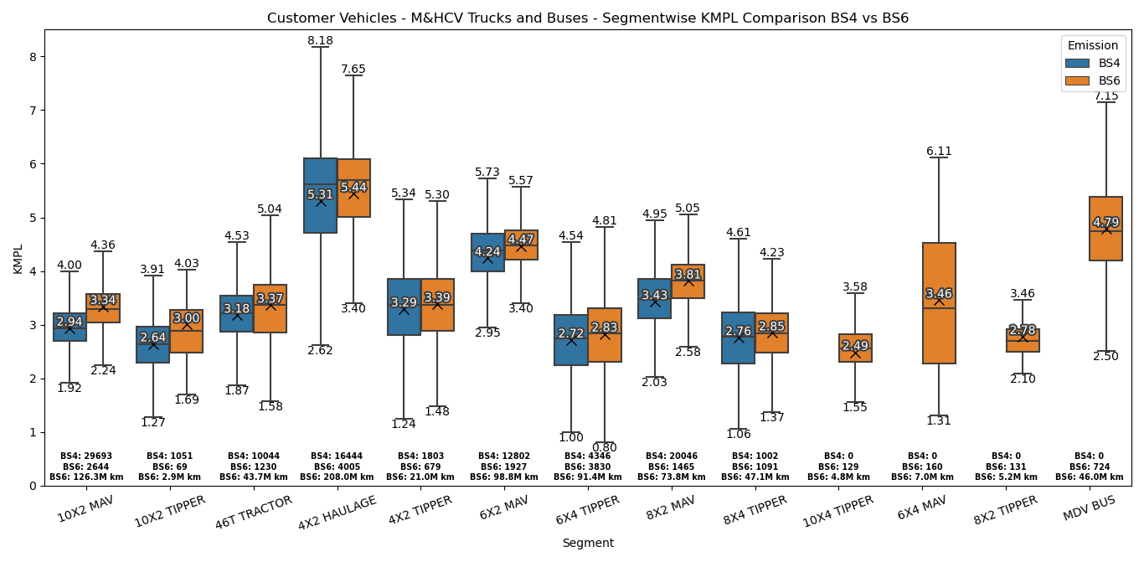
H6 2V M&HCV Trucks and Buses – BS4 Vs. BS6 KMPL Comparison
BS6 – Vehicles covered >3000kms

Slide 4
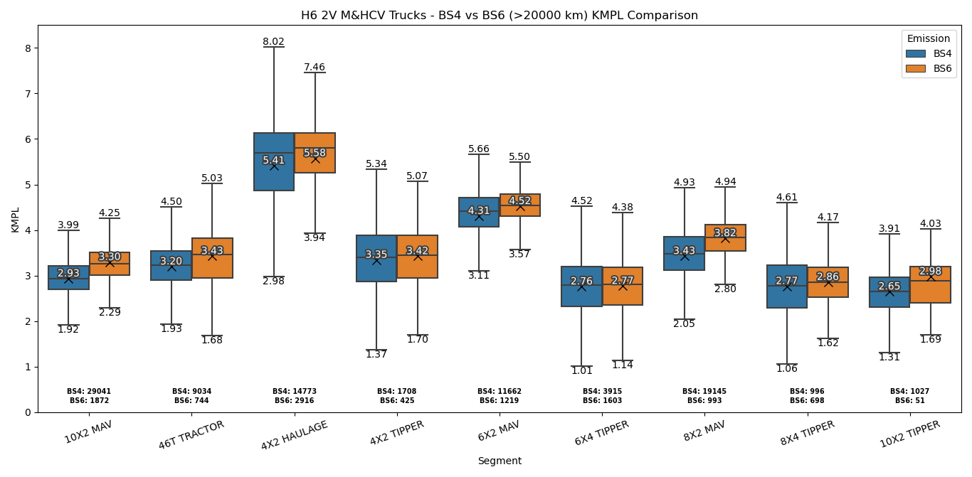
H6 2V M&HCV Trucks – BS4 Vs. BS6 (>20000kms) KMPL Comparison
+ 3%
+ 9%
+ 2%
+ 2%
+ 4%
+ 1%
+ 7%
+ 2%
T-test mean at 95% significant level
Low volume samples are not included due to high variations
Average KMPL in BS6 marginally improved further after 20000kms due to effect of bedding in.

Slide 5
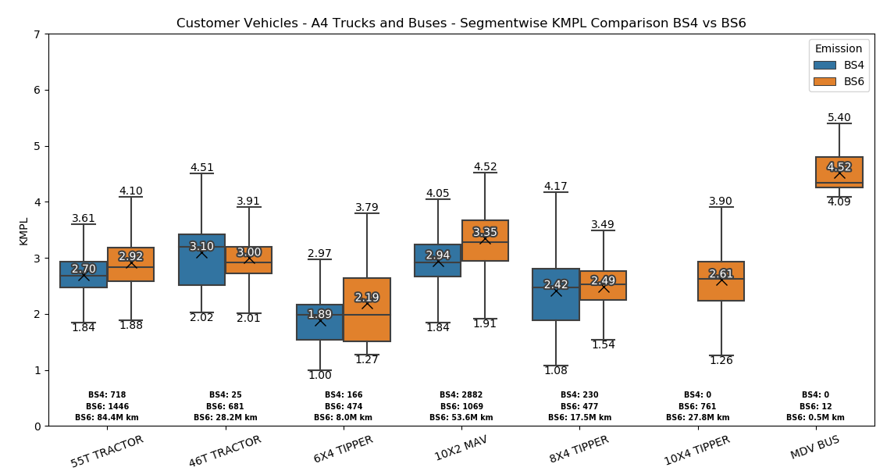
A4 Trucks – BS4 vs BS6 KMPL Comparison
No improvement in mean
+6%
No improvement in FE is seen in 46T application as in BS6 this is operated in 52T & 54T Overload applications. Comparison models in BS4 is 41T & 42T application
+7%
+14%
+4%
T-Test Mean at 95% Significant level
BS6 - Vehicles covered > 3000kms

Slide 6
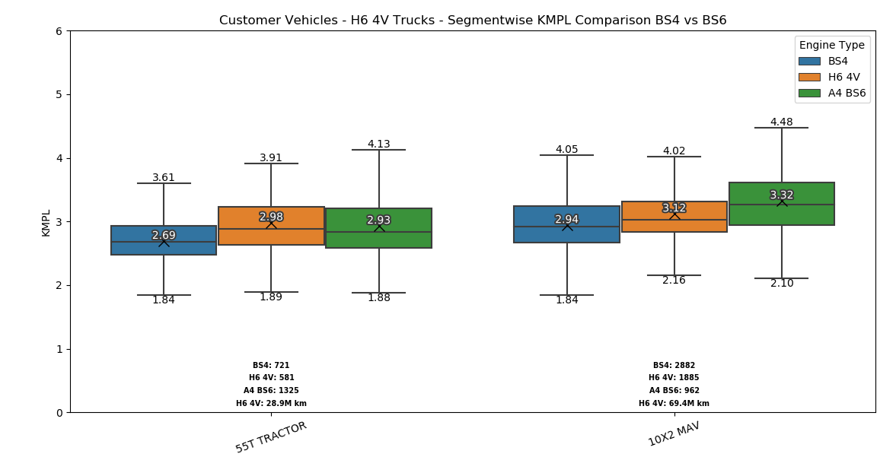
Trucks – BS4 vs H6 4V vs A4 KMPL Comparison
H64V vehicles are separately monitored.
Total Number of commissioned vehicles: 3898
Total Number of vehicles crossed 3k: 2956
Total Number of vehicles crossed 10K: 2466
T-Test Mean at 95% Significant level
Each values are w.r.t BS4
+9%
+7%
+4%
+11%
More Overload operations observed in A4 Tractor, resulted in Lower mean than H64V.
BS6 - Vehicles covered > 10000kms

Slide 7
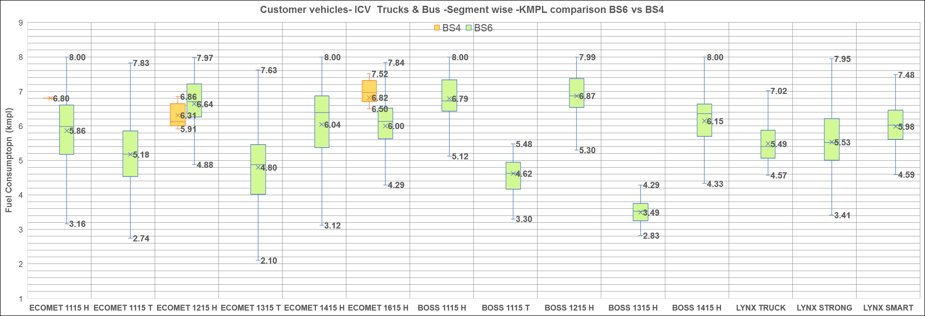
ICV Trucks & Bus– BS4 Vs. BS6 KMPL Comparison
Road sweeper and Compactor application
Sample size
BS4 - 1 BS6 – 297 BS6- 6618K kms | BS4 - NA BS6 – 435 BS6- 9318K kms | BS4 - 7 BS6 - 261 BS6 –11553K kms | BS4 - NA BS6 – 368 BS6 -8911K kms | BS4 - NA BS6 - 554 BS6 -23954kms | BS4 - 14 BS6 - 3844 BS6-160975K kms | BS4 – NA BS6 – 172 BS6 -5711K kms | BS4 - NA BS6 – 16 BS6 -484 K kms | BS4 - NA BS6 - 508 BS6 -27148K kms | BS4 - NA BS6 – 73 BS6 -2020K kms | BS4 - NA BS6 – 274 BS6 -13396K kms | BS4 - NA BS6 – 32 BS6 - 233 kms | BS4 - NA BS6 – 181 BS6 - 8990 kms | BS4 - NA BS6 – 145 BS6 - 6298K kms
*Data samples is lesser in BS4 due to non availability of telematics in ICV vehicles
BS6 – Vehicles covered >3000kms

Slide 8
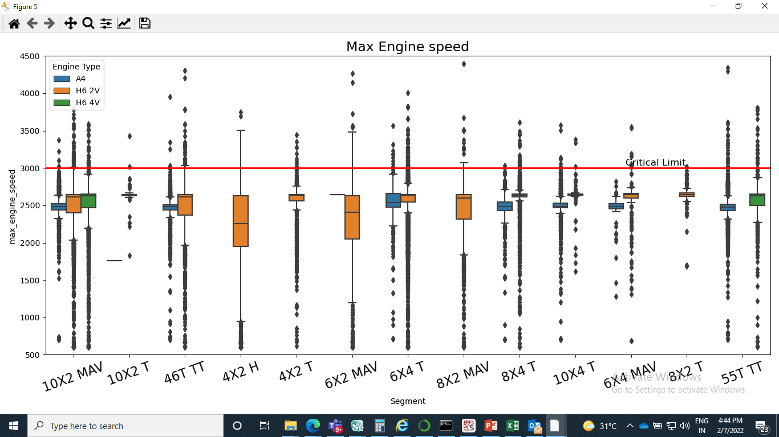
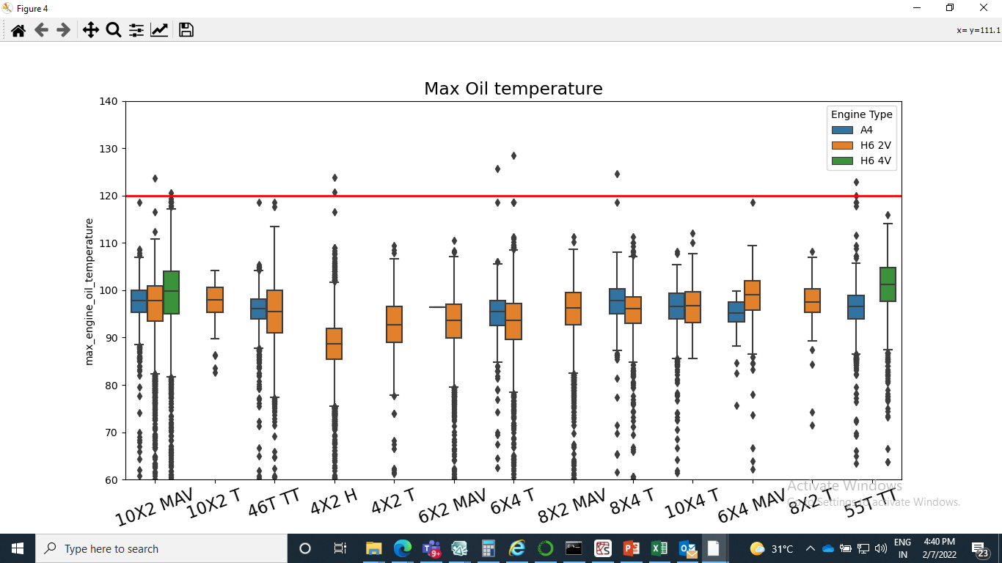
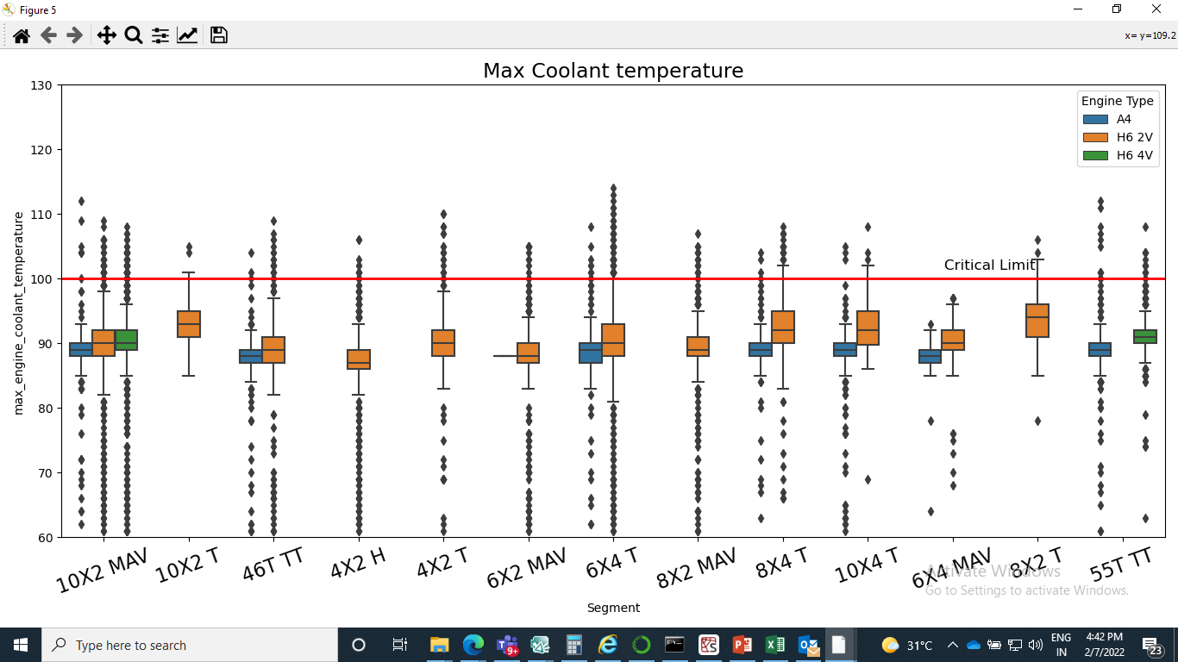
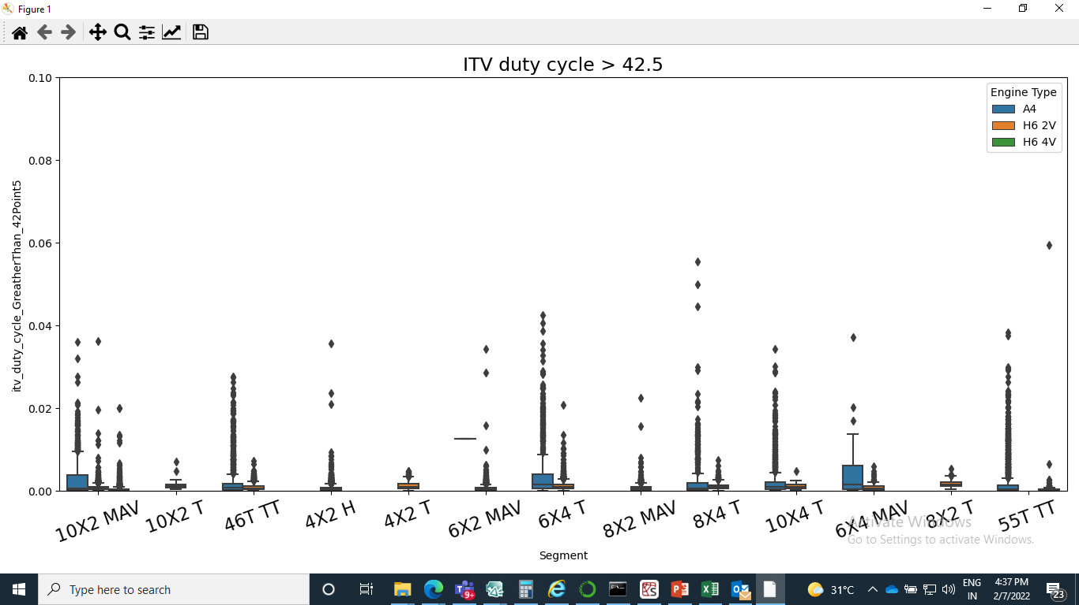
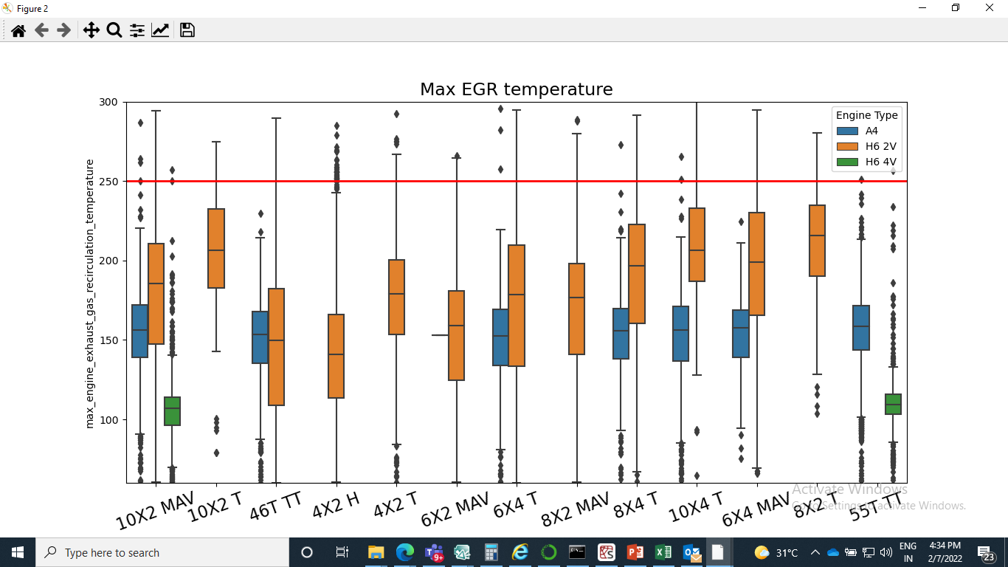
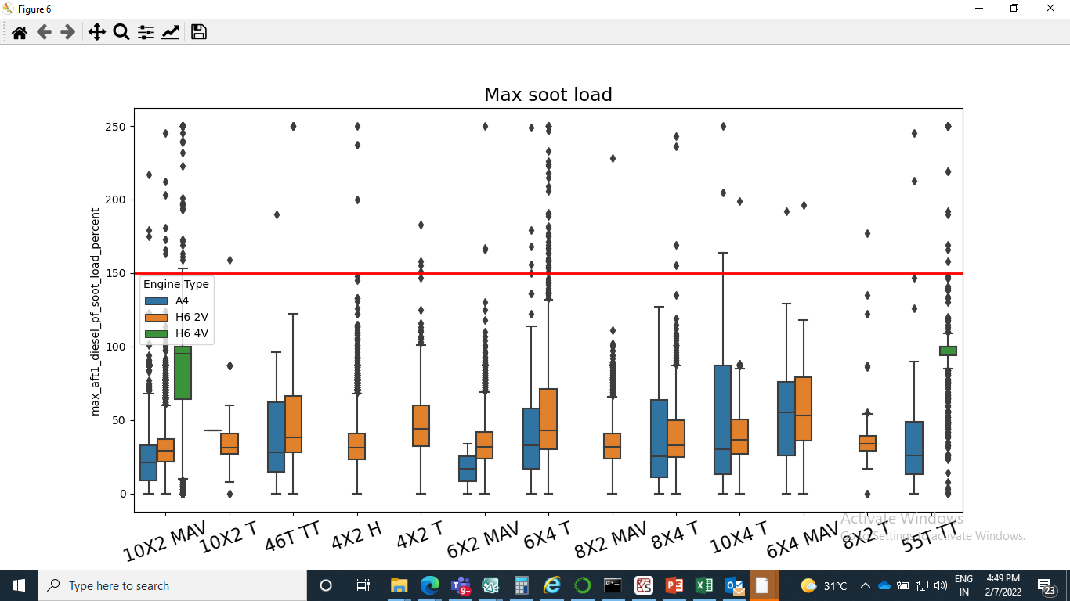
Engine & EATS Performance Dashboard – MBP Trucks
Engine speed crossed 4000 rpm due to gear mis-shift and gear down shift at higher vehicle speeds.
Coolant Overheat issues seen in H6 4V vehicles during Gradient drive. Other vehicles are due to hot shutdown.

Slide 9
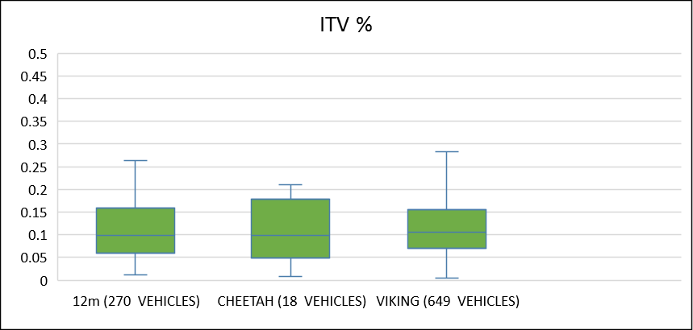
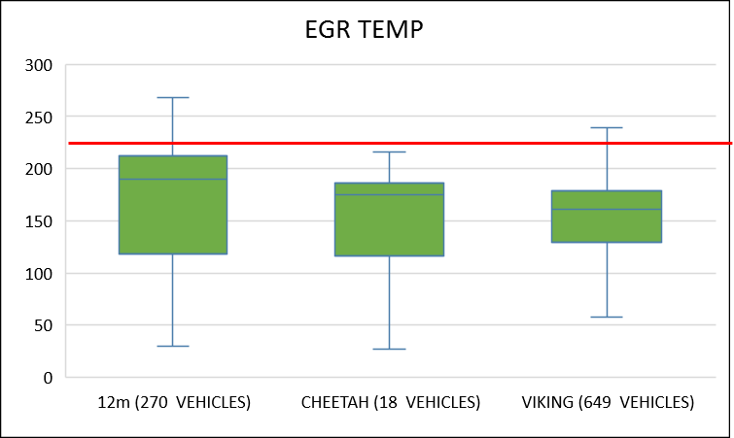
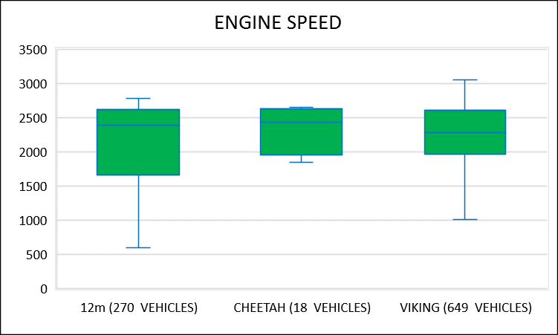
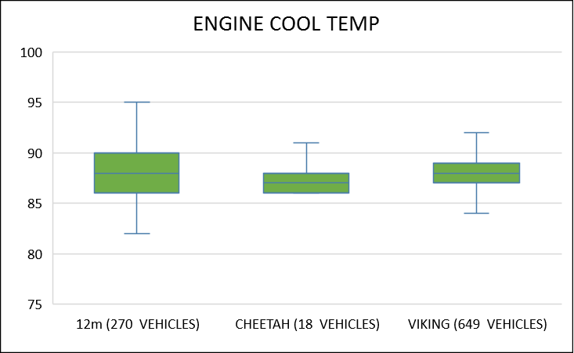
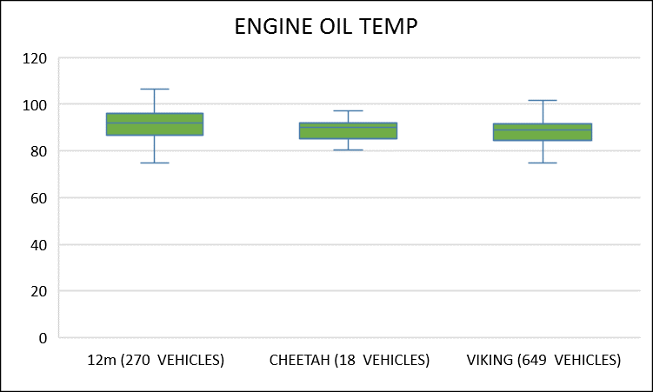
Engine Performance Dashboard – MBP Buses
Engine Parameters | Model
 | Viking | Cheetah | 12m
ITV Duty cycle
EGR Temperature
Oil temperature
EGR temperature
Engine speed

Slide 10
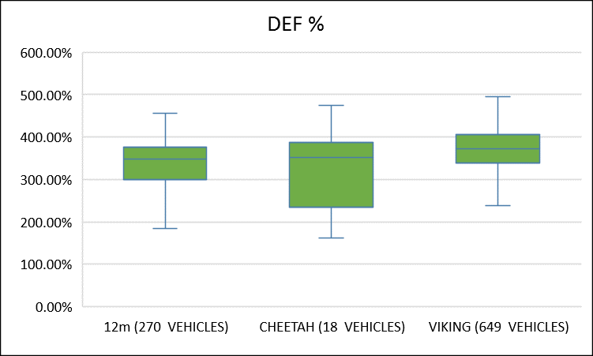
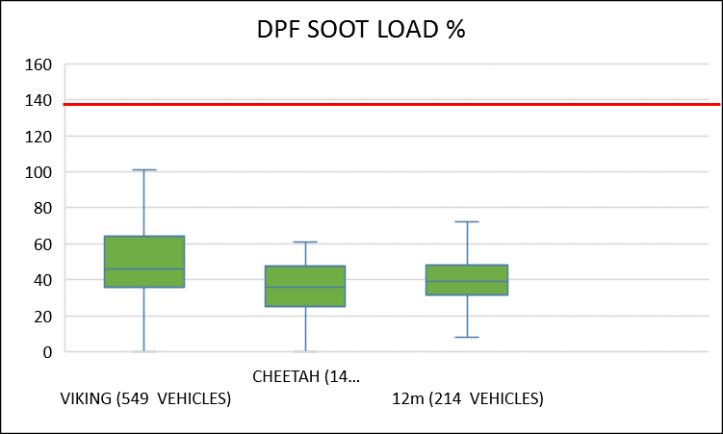
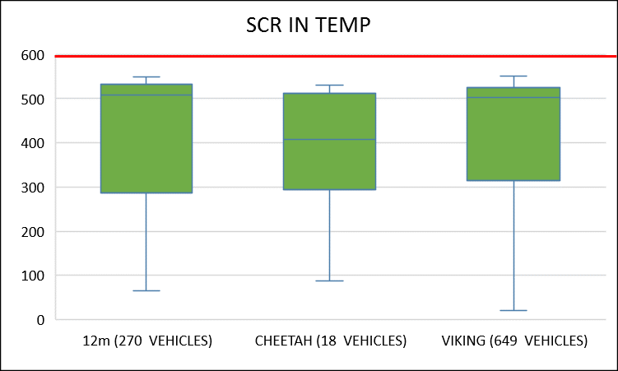
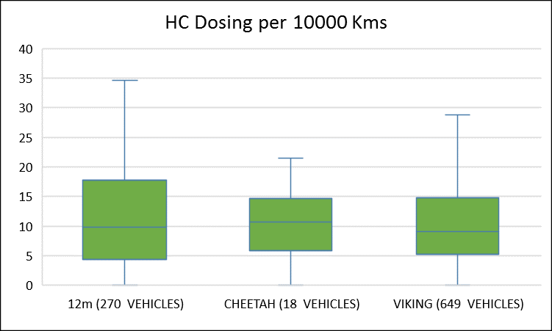
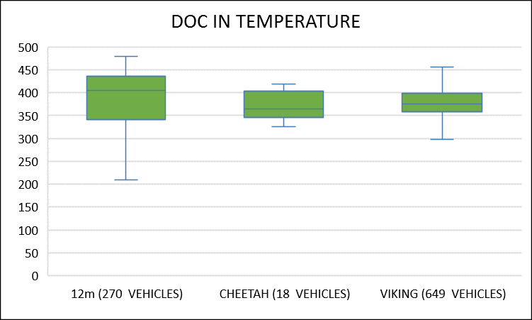
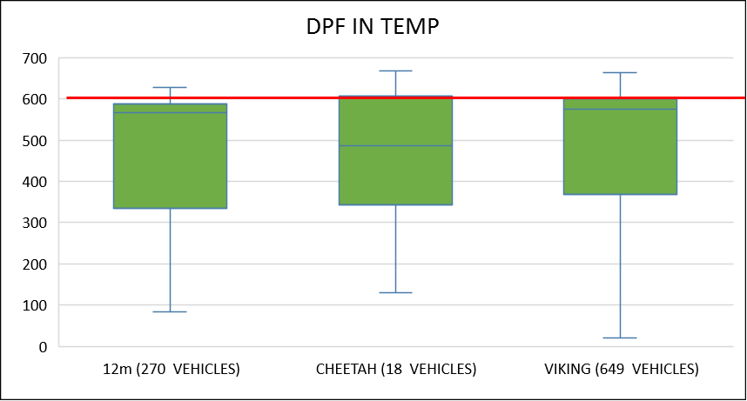
EATS Performance Dashboard – MBP Buses
Engine Parameters | Model
 | Viking | Cheetah | 12m
DOC in temp
DPF in temp
SCR in temp
Soot Load

Slide 11
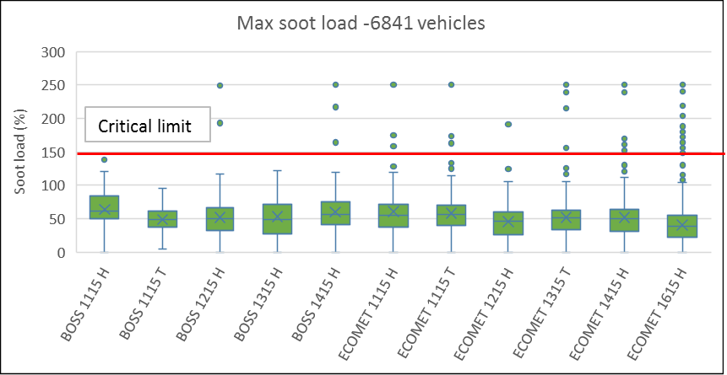
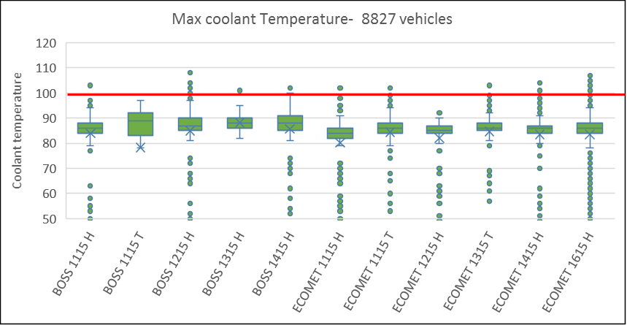
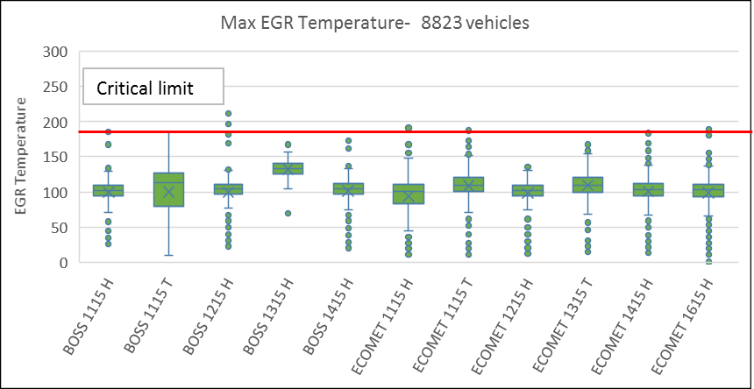
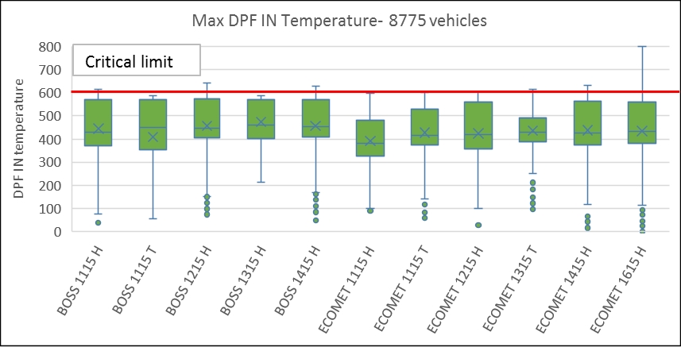
Engine & EATS performance dashboard– ICV Trucks

Slide 12
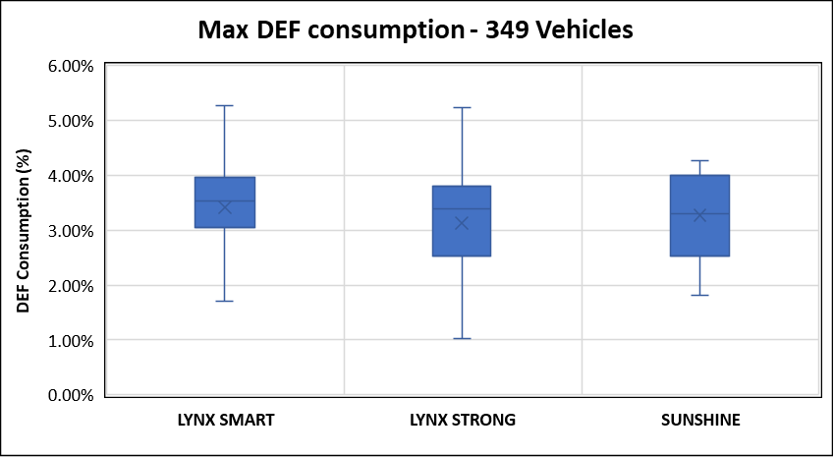
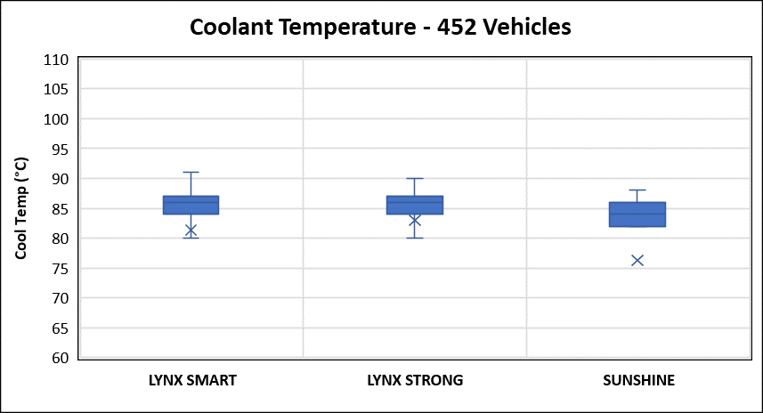
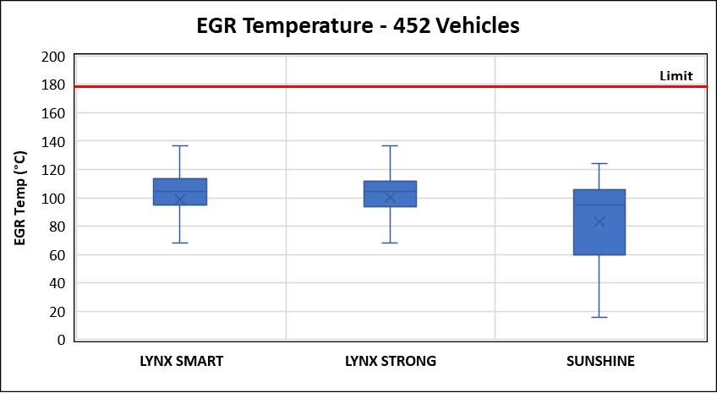
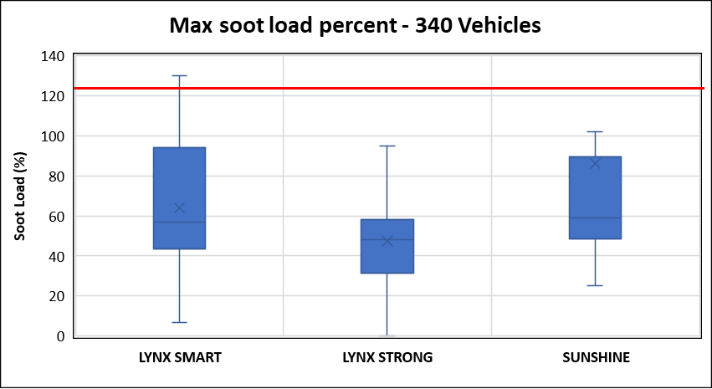
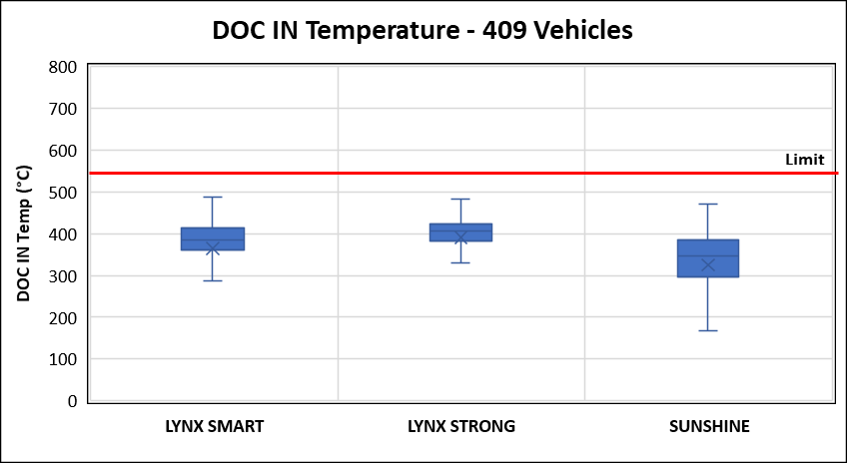
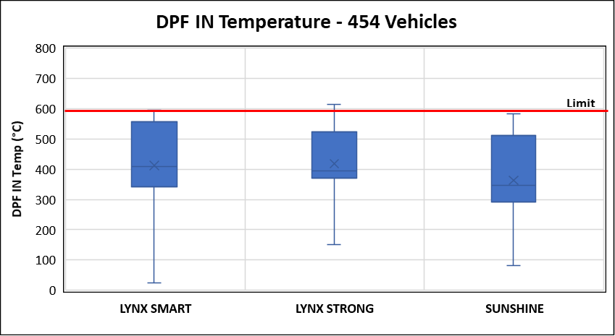
Engine and EATS Performance Dashboard – ICV Buses
* All Engine and EATS parameters were found to be within limit
Engine/EATS Parameters | LYNX SMART | LYNX STRONG | SUNSHINE
Cool temp
EGR Temp
DOC in temp
DPF in temp
Soot Load
Vehicle Model | No. of Vehicles Commissioned
LYNX SMART | 183
LYNX STRONG | 153
SUNSHINE | 13
TOTAL COMMISSIONED VEHICLES | 349

